Slide 1
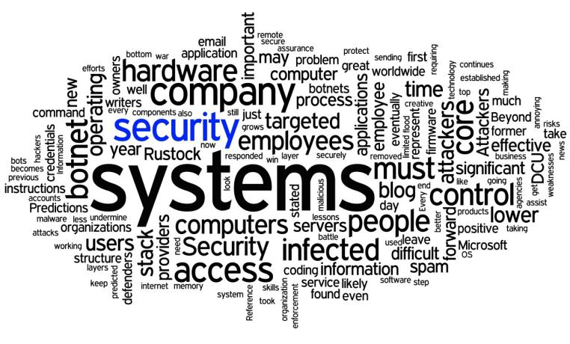
NEED OF IT SECURITY
School of Computer Science and IT JAIN (DEEMED-TO-BE UNIVERSITY) Department of Bachelor of Computer Applications
Module 2

Slide 2

Topics to be covered :
Categories of Threats
Deliberate software attacks
Other types of attacks
Common DOS attacks

Slide 3

Business needs
Information security performs four important functions for an organization
Protecting the organization’ s ability to function
Enabling the safe operation of application running on the organization
Protecting the data the organization collects and uses
Safeguarding the organization’s technology assets

Slide 4
To protect an organization’s information, you must
Know your self
Know the threats you face

Slide 5
Categories of Threats:
Acts of Human Error or failure Accident and employee mistake
Compromises to intellectual property Privacy, Copyright infringement
Deliberate acts of espionage or trespass Unauthorized access (CI,IS & SS)
Deliberate acts of information extortion Blackmail
Deliberate acts of sabotage and vandalism Destruction
Deliberate acts of theft
Deliberate software attacks Virus, Worms, Macros and DOS
Forces of nature Fire, Flood, Earthquake
Technical hardware failures or errors Equipment failure
Technical software failures or errors Bugs, Code problems
Technological obsolescence Outdated Technologies

Slide 6
Deliberate software attack
Virus
Worms
Trojan Horses
Back Door or Trap Door
Polymorphic threats
Hoaxes
Other types of attacks

Slide 7
Virus
Computer virus is a harmful software program written intentionally to enter a computer without the user's permission or knowledge.
A computer virus is a malware program that, when executed, replicates by inserting copies of itself (possibly modified) into other computer programs, data files, or the boot sector of the hard drive
Characteristics of Computer Viruses:
Propagates when the host program is executed.
Has an incubation period, during which no damage is done.
After incubation period, begins to manifest its behavior.

Slide 8
Types of Virus
Memory Resident Virus
Direct action virus
Overwrite virus
Boot sector virus
Macro virus
Polymorphic virus
Web scripting virus

Slide 9
Types of Virus
Memory Resident Virus : These viruses fix themselves in the computer memory and get activated whenever the OS runs and infects all the files that are then opened.
Target: It can corrupt files and programs that are opened, closed, copied, renamed, etc.
Examples: Randex, CMJ, Meve, and MrKlunky
Direct Action Virus : The main purpose of this virus is to replicate and take action when it is executed. When a specific condition is met, the virus will go into action and infect files AUTOEXEC.BAT file path. This batch file is always located in the root directory of the hard disk and carries out certain operations when the computer is booted.
Target: It is a file-infecter virus.
Examples: Vienna virus

Slide 10
Types of Virus
Overwrite Viruses : A virus of this kind is characterized by the fact that it deletes the information contained in the files that it infects, rendering them partially or totally useless once they have been infected.
Hideout: The virus replaces the file content. However, it does not change the file size.
Examples: Way, Trj.Reboot, Trivial.88.D
Boot Sector Virus : This type of virus affects the boot sector of a hard disk. This is a crucial part of the disk, in which information of the disk itself is stored along with a program that makes it possible to boot (start) the computer from the disk.
Examples: Polyboot.B, AntiEXE

Slide 11
Types of Virus
Macro Virus : Macro viruses infect files that are created using certain applications or programs that contain macros, like .doc, .xls, .pps, etc.
Hideout: These hide in documents that are shared via e-mail or networks. Examples: Relax, Melissa.A, Bablas, O97M/Y2K
Polymorphic Virus : Polymorphic viruses encrypt or encode themselves in a different way (using different algorithms and encryption keys) every time they infect a system.
This makes it impossible for antivirus software to find them using string or signature searches.
Examples: Elkern, Marburg, Satan Bug and Tuareg

Slide 12
Types of virus
Web Scripting Virus : Many web pages include complex codes in order to create an interesting and interactive content. This code is often exploited to bring about certain undesirable actions.
Examples: JS.Fortnight

Slide 13
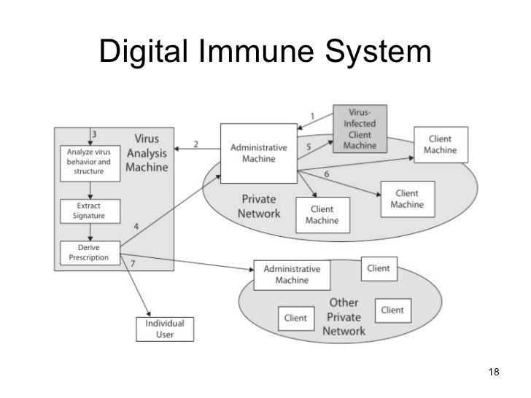

Slide 14
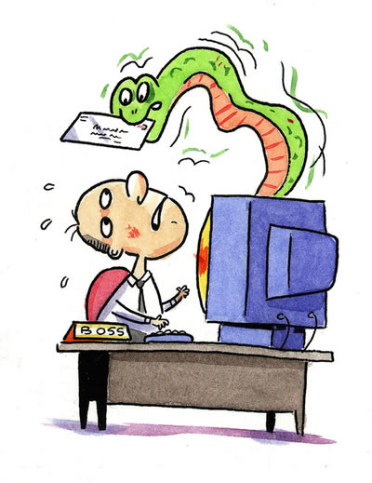
Worms
A computer worm is a standalone malware computer program that replicates itself in order to spread to other computers.
It uses a computer network to spread itself, relying on security failures on the target computer to access it. Unlike a computer virus, it does not need to attach itself to an existing program.

Slide 15
Types of Worms
E-mail Worms: Email Worms spread through infected email messages as an attachment or a link of an infected website.
Instant Messaging Worms: Instant Messaging Worms spread by sending links to the contact list of instant messaging applications.
Internet Worms: Internet worm will scan all available network resources using local operating system services and/or scan the Internet for vulnerable machines. If a computer is found vulnerable it will attempt to connect and gain access to them.
File-sharing Networks Worms: File-sharing Networks Worms place a copy of them in a shared folder and spread via P2P network.

Slide 16
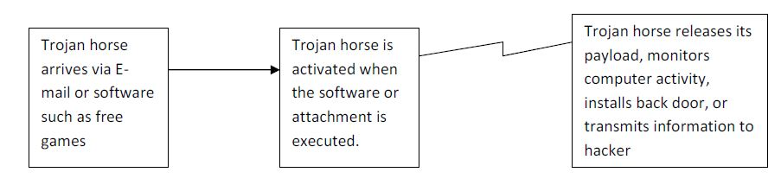
Trojan Horses
A Trojan horse, or Trojan, in computing is generally a non-self-replicating type of malware program containing malicious code that, when executed, carries out actions determined by the nature of the Trojan, typically causing loss or theft of data, and possible system harm.
A Trojan often acts as a backdoor
A Trojan may give a hacker remote access to a targeted computer system

Slide 17
How Trojans can impact you
Trojans are classified according to the type of actions that they can perform on your computer:
Backdoor : A backdoor Trojan gives malicious users remote control over the infected computer.
They enable the author to do anything they wish on the infected computer – including sending, receiving, launching and deleting files, displaying data and rebooting the computer.
Root kit : Rootkits are designed to conceal certain objects or activities in your system.
Often their main purpose is to prevent malicious programs being detected – in order to extend the period in which programs can run on an infected computer.

Slide 18
How Trojans can impact you
Trojan-Banker : Trojan-Banker programs are designed to steal your account data for online banking systems, e-payment systems and credit or debit cards.
Trojan-DDoS : These programs conduct DoS (Denial of Service) attacks against a targeted web address. By sending multiple requests – from your computer and several other infected computers – the attack can overwhelm the target address… leading to a denial of service.
Trojan-Downloader :Trojan-Downloaders can download and install new versions of malicious programs onto your computer – including Trojans and adware.
Trojan-GameThief :This type of program steals user account information from online gamers.
Trojan-Ransom :This type of Trojan can modify data on your computer – so that your computer doesn’t run correctly or you can no longer use specific data. The criminal will only restore your computer’s performance or unblock your data, after you have paid them the ransom money that they demand.

Slide 19
Backdoor /Trap doors
A backdoor in a computer system (or cryptosystem or algorithm) is a method of bypassing normal authentication, securing unauthorized remote access to a computer, obtaining access to plaintext, and so on, while attempting to remain undetected.
The backdoor may take the form of a hidden part of a programme separate program (e.g., Back Orifice) may subvert the system through a root kit
Default passwords can function as backdoors if they are not changed by the user. Some debugging features can also act as backdoors if they are not removed in the release version.

Slide 20
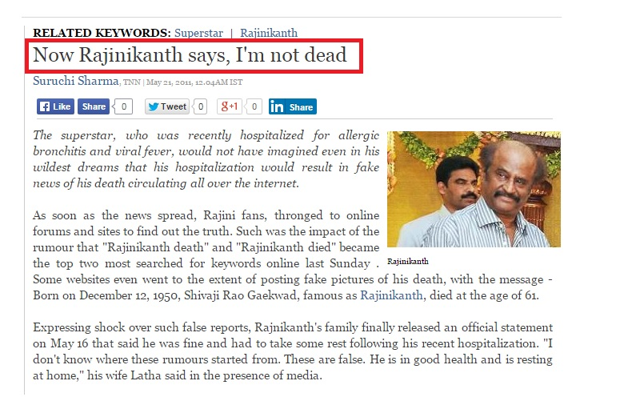
Hoaxes
A computer virus hoax is a message warning the recipients of a non-existent computer virus threat. The message is usually a chain e-mail that tells the recipients to forward it to everyone they know.

Slide 21
Other Types of Attacks
IP Spoofing
Sniffing
Password guessing attack
Brute force attack
Dictionary attack
Man in the middle
Social engineering
DOS attack

Slide 22
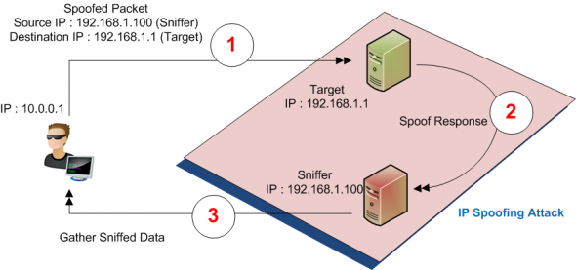
Other Types of Attacks
IP spoofing - An attacker may fake their IP address so the receiver thinks it is sent from a location that it is not actually from. There are various forms and results to this attack.
Gaining access through source routing. Hackers may be able to break through other friendly but less secure networks and get access to your network using this method.
E.g: Colasoft,Spoofer

Slide 23
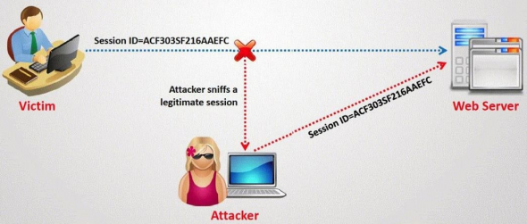
Sniffing Attack
Sniffing attack : They refer to listening to a conversation.
For example, if you login to a website that uses no encryption, your username and password can be sniffed off the network by someone who can capture the network traffic between you and the web site.
E.g : Wireshark , tcpdump , netstumbler.

Slide 24
Password guessing attack
Unauthorized user repeatedly tries to log on to a computer or network by guessing usernames and passwords.
Password Guessing
Brute Force Attack
Dictionary attack
Brute Force Attack :
Brute force attack is a type of password guessing attack. In this type of attack, attackers systematically try every conceivable combination to find out the password of a user.
E.g: Aircrack-ng, Cain and abel,Crack

Slide 25
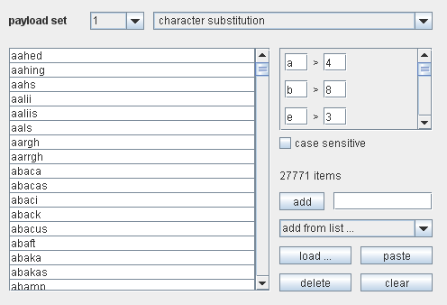
Brute force attack
Password guessing program
Download link :
http://portswigger.net/burp/help/intruder.html

Slide 26
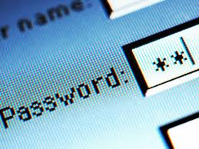

Dictionary attack
This type of attack uses a dictionary of common words to find out the password of a user. It can also use common words in either upper or lower case to find a password. There are many programs available on the Internet to automate and execute dictionary attacks.
E.g : Brutus,Cain and abel

Slide 27
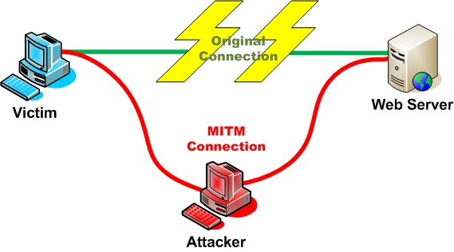
Occur when an attacker successfully inserts an intermediary software or program between two communicating systems.
The MITM attack is very effective because of the nature of the http protocol and data transfer which are all ASCII based.
It’s possible to capture a session cookie reading the http header, but it’s also possible to change an amount of money transaction inside the application context.
E.g : Eavesdropping

Slide 28
Social Engineering Attack
Social engineering attacks can take place both online and offline. Online social engineering attacks usually take the form of phishing or pharming attempts, which present unsuspecting users with legitimate-looking emails or websites in order to convince to part with important information or money.
Another form of online social engineering involves convincing a user to download a file, usually in the guise of a security or application update, game or other desired program.
Once downloaded and run however, the file turns out to be something entirely different, and almost always malicious.
Despite the simplicity of many social engineering attacks, they tend to be consistently effective, as they exploit natural human tendencies based on trust, desire or curiosity.

Slide 29
Phishing Attack
Phishing is a type of deception designed to steal your valuable personal data, such as credit card numbers, passwords, account data, or other information.
Con artists might send millions of fraudulent e-mail messages that appear to come from Web sites you trust, like your bank or credit card company, and request that you provide personal information.
Banking Link Scam: Hackers send you an email with a phony link to your bank, tricking you into entering in your bank ID and password.
Face book Message Link Scam: Vin Diesel has just died. Find out that your PC will be pushing up the daisies with this link.

Slide 30
PRETexting Attack
Pretexting is another form of social engineering where attackers focus on creating a good pretext, or a fabricated scenario, that they can use to try and steal their victims’ personal information.
These types of attacks commonly take the form of a scammer who pretends that they need certain bits of information from their target in order to confirm their identity.
Baiting
Baiting is in many ways similar to phishing attacks. However, what distinguishes them from other types of social engineering is the promise of an item or good that hackers use to entice victims.
Baiters may offer users free music or movie downloads, if they surrender their login credentials to a certain site.
Baiting attacks are not restricted to online schemes, either. Attackers can also focus on exploiting human curiosity via the use of physical media.

Slide 31
Critical Characteristics Of Information
The value of information comes from the characteristics it possesses.
Privacy
Identification
Authentication
Authorization
Accountability
Accuracy
Utility
Possession

Slide 32
Quid Pro Quo
Something for something. Enticing the users with winning prizes or discounts on expensive products, this scam offers users “something” but only after they fill out a form that wants you to include most of your personal information. Then all of that data collected is used for identity theft.

Slide 33
DoS attack
It is also known as “network saturation attack” or “bandwidth consumption attack”.
Attackers make Denial-of-Service attacks by sending a large number of protocol packets to a network.
Consequences of DoS
Saturate network resources.
Disrupt connections between two computers, thereby preventing communication between services.
Disrupt services to a specific computer.

Slide 34

Common DoS Attacks
SYN attack
PING flood
Ping of death
Teardrop attack
Smurf attack

Slide 35
SYN attack/SYN flooding
A SYN attack affects computers running on the TCP/IP protocol.
An attacker sends multiple SYN packets to the target computer.
For each SYN packet received, the target computer allocates resources and sends an acknowledgement (SYN-ACK) to the source IP address. Since the target computer does not receive a response from the attacking computer, it attempts to resend the SYN-ACK.
This leaves TCP ports in a half-open state. When an attacker sends TCP SYNs repeatedly, the target computer eventually runs out of resources and is unable to handle any more connections, thereby denying services to legitimate users.

Slide 36
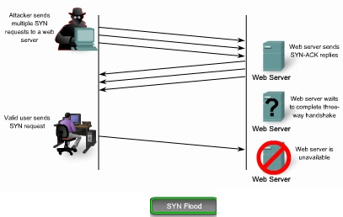
Diagram show SYN flood

Slide 37
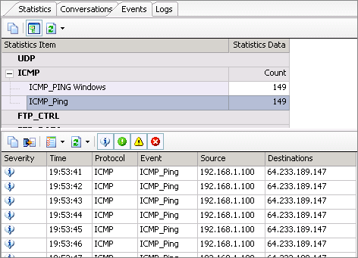
PING flood
It relies on the ICMP echo command, more popularly known as ping .
In legitimate situations the ping command is used by network administrators to test connectivity between two computers.
In the ping flood attack, it is used to flood large amounts of data packets to the victim’s computer in an attempt to overload it.
Target – Targeted system , Router or blind ping

Slide 38
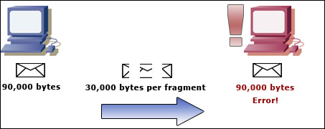
Ping of death
The maximum size for a packet is 65,535 bytes. If one were to send a packet larger than that, the receiving computer would ultimately crash from confusion.
Sending a ping of this size is against the rules of the TCP/IP protocol, but hackers can bypass this by cleverly sending the packets in fragments. When the fragments are assembled on the receiving computer, the overall packet size is too great. This will cause a buffer overflow and crash the device.

Slide 39
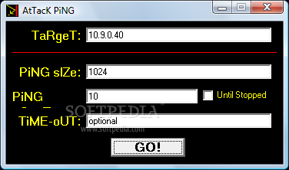
Software to ping attack
Download Link:-
http://www.softpedia.com/progScreenshots/AtTacK-PiNG-Screenshot-80794.html

Slide 40
Teardrop Attack
A teardrop attack is a denial of service (DoS) attack conducted by targeting TCP/IP fragmentation reassembly codes.
This attack causes fragmented packets to overlap one another on the host receipt; the host attempts to reconstruct them during the process but fails.
Gigantic payloads are sent to the machine that is being targeted, causing system crashes.

Slide 41
Smurf Attack
A smurf attack is a type of denial of service attack in which a system is flooded with spoofed ping messages. This creates high computer network traffic on the victim’s network, which often renders it unresponsive.
Smurfing takes certain well-known facts about Internet Protocol and Internet Control Message Protocol (ICMP) into account.
ICMP is used by network administrators to exchange information about network state, and can also be used to ping other nodes to determine their operational status.
The smurf program sends a spoofed network packet(broadcasting) that contains an ICMP ping. The resulting echo responses to the ping message are directed toward the victim’s IP address.
Large number of pings and the resulting echoes can make the network unusable for real traffic.

Slide 42
Thank You

